Slide 1
Happy Mothers Day!
.

Slide 2
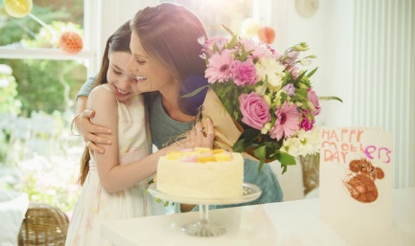
Мама – самое первое слово, произнесенное ребенком. В нем спрятана необъятная любовь, трогательная нежность и забота матери о своем чаде. Именно материнство является началом всех начал, родником человеческой жизни.

Slide 3
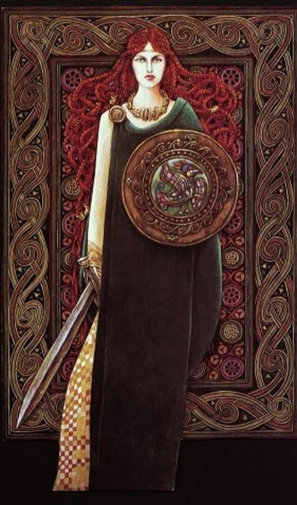
Эпоха античности
Почитание матерей много веков назад существовало еще в Древней Греции. Жители этой сказочной страны поклонялись в один из весенних дней Гее — матери всех богов. Древние кельты чествовали в праздничный день богиню Бриджит, а у римлян существовал трехдневный мартовский праздник, в который они воспевали родительницу своих покровителей — Кибеле.

Slide 4
По мере того как христианская религия распространялась по Европе, праздник стал популярен среди прихожан и отмечался как День Матери Церкви – сильнейшей защитницы, оберегающей от зла и дающей новую жизнь.

Slide 5
В Беларуси День матери отмечается
14 октября, он приурочен к дате Покрова Пресвятой Богородицы –
великого
православного
праздника.

Slide 6
В Великобритании еще в далеком 17 веке было принято отмечать «Материнское воскресенье».
В этот день юноши и девушки, которые работали подмастерьями или слугами, возвращались домой на 1 день и приносили в подарок своим мамам марципановый пирог.
Отмечают праздник в Англии в первое воскресенье марта.

Slide 7
Примерно в этот же период времени праздник, подобный английскому, появился во Франции и в Бельгии. Чуть позже, в 19-м веке, праздник День матери начали отмечать жители США, Украины, Эстонии, Дании, Финляндии, Германии, Италии, Турции, Австралии, Японии, Бразилии и др.
В основном, в мире
День матери
отмечается
во второе
воскресенье мая

Slide 8
День матери — праздник международный.
во многих странах праздник отмечается в разные времена года, общепринято в этот день дарить своим мамам цветы, подарки, открытки с поздравлениями, устраивать концерты и разнообразные праздничные мероприятия, т.е. проявлять свою любовь и уважение.
.

Slide 9
Интересно:
В США в День матери принято носить гвоздики в петлице пиджака, красная — мама жива, белая — мама уже на небесах.
В Австралии дети обязательно приносят своим мамам завтрак в постель и дарят подарки.
В Великобритании дети в этот день дарят матерям цветы и выполняют за них работу
по дому.
У нас нет определенных
традиций в этот день. И все те,
у кого есть мама, поздравляют
своих матерей — звонком по телефону, открыткой, или иными подарками — каждый решает сам.

Slide 10
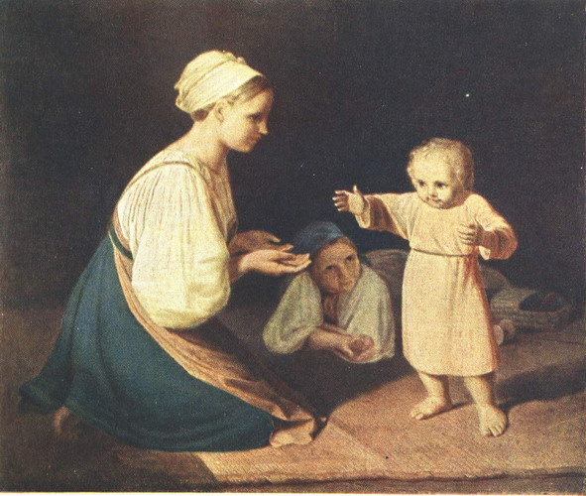
Интересно:
Женщина, мать стала воплощением кисти великих мастеров искусства, а также это одно из самых глубоких и гармоничных созданий поэзии.

Slide 11
Любите, цените и берегите своих мам! Они самые лучшие!!!

Slide 12
$1 Million
$500,000
$250,000
$125,000
$64,000
$32,000
$16,000
$8,000
$4,000
$2,000
$1,000
$500
$300
$200
$100
Notes:
This game plays just like the popular Who Wants to be a Millionaire?®. ***How to set up this game template*** 1. Come up with fifteen questions of increasing difficulty. Also include four answers for each question (3 wrong answers, 1 correct answer). 2. Number each question with the easiest question being #1 and the hardest question being #15. 3. Enter each question and its four answers into the following slides:
Question #1 – Enter into slide 2 Question #2 – Enter into slide 4 Question #3 – Enter into slide 6 Question #4 – Enter into slide 8 Question #5 – Enter into slide 10 Question #6 – Enter into slide 13
Question #7 – Enter into slide 15 Question #8 – Enter into slide 17 Question #9 – Enter into slide 19 Question #10 – Enter into slide 21 Question #11 – Enter into slide 24 Question #12 – Enter into slide 26 Question #13 – Enter into slide 28 Question #14 – Enter into slide 30 Question #15 – Enter into slide 32 ***How to play Who Wants to Be a Millionaire?***
1. Have your students complete this game together! Pick 15 students and number them from one to fifteen. Student one answers the first question, student two answers the second question, etc.. © 2012 Any redistribution or reproduction of part or all of the contents in any form is prohibited. You may not distribute or commercially exploit the content. Nor may you transmit it or store it in any other website or other form of electronic retrieval system.

Slide 13
$100 Question
Какой праздник отмечают в Беларуси 14 октября?
50:50
Proceed
A:Father`s Day
B:Mother`s Day
C: children`s Day
D:Family Day
Notes:
Notes: 1. Enter the question in the “Type the question here.” text field. 2. Enter the three wrong answers in the “Answer (wrong)” text fields. 3. Enter the correct answer in the “Answer (correct)” field. © 2012 Any redistribution or reproduction of part or all of the contents in any form is prohibited. You may not distribute or commercially exploit the content. Nor may you transmit it or store it in any other website or other form of electronic retrieval system.

Slide 14
$1 Million
$500,000
$250,000
$125,000
$64,000
$32,000
$16,000
$8,000
$4,000
$2,000
$1,000
$500
$300
$200
$100
Notes:
Notes: You do not need to edit this slide in order to play the game. © 2012 Any redistribution or reproduction of part or all of the contents in any form is prohibited. You may not distribute or commercially exploit the content. Nor may you transmit it or store it in any other website or other form of electronic retrieval system.

Slide 15
$500 Question
В какой стране в античные времена зародился праздник Матерей?
50:50
Proceed
A: Великобритания
B: Япония
C: Америка
D: Греция
Notes:
Notes: 1. Enter the question in the “Type the question here.” text field. 2. Enter the three wrong answers in the “Answer (wrong)” text fields. 3. Enter the correct answer in the “Answer (correct)” field. © 2012 Any redistribution or reproduction of part or all of the contents in any form is prohibited. You may not distribute or commercially exploit the content. Nor may you transmit it or store it in any other website or other form of electronic retrieval system.

Slide 16
$1 Million
$500,000
$250,000
$125,000
$64,000
$32,000
$16,000
$8,000
$4,000
$2,000
$1,000
$500
$300
$200
$100
Notes:
Notes: You do not need to edit this slide in order to play the game. © 2012 Any redistribution or reproduction of part or all of the contents in any form is prohibited. You may not distribute or commercially exploit the content. Nor may you transmit it or store it in any other website or other form of electronic retrieval system.

Slide 17
$1,000 Question
В какой стране праздник начали отмечать в XVII веке как “Материнское Воскресенье”?
50:50
Proceed
A: Беларусь
B: Франция
C: Греция
D: Великобритания
Notes:
Notes: 1. Enter the question in the “Type the question here.” text field. 2. Enter the three wrong answers in the “Answer (wrong)” text fields. 3. Enter the correct answer in the “Answer (correct)” field. © 2012 Any redistribution or reproduction of part or all of the contents in any form is prohibited. You may not distribute or commercially exploit the content. Nor may you transmit it or store it in any other website or other form of electronic retrieval system.

Slide 18
Proceed
Notes:
Notes: You do not need to edit this slide in order to play the game. © 2012 Any redistribution or reproduction of part or all of the contents in any form is prohibited. You may not distribute or commercially exploit the content. Nor may you transmit it or store it in any other website or other form of electronic retrieval system.

Slide 19
$1 Million
$500,000
$250,000
$125,000
$64,000
$32,000
$16,000
$8,000
$4,000
$2,000
$1,000
$500
$300
$200
$100
Notes:
Notes: You do not need to edit this slide in order to play the game. © 2012 Any redistribution or reproduction of part or all of the contents in any form is prohibited. You may not distribute or commercially exploit the content. Nor may you transmit it or store it in any other website or other form of electronic retrieval system.

Slide 20
$4,000 Question
Когда отмечают праздник в Великобритании?
50:50
Proceed
A: третье воскресенье ноября
B: 14 октября
C: первое воскресенье марта
D: второе воскресенье мая
Notes:
Notes: 1. Enter the question in the “Type the question here.” text field. 2. Enter the three wrong answers in the “Answer (wrong)” text fields. 3. Enter the correct answer in the “Answer (correct)” field. © 2012 Any redistribution or reproduction of part or all of the contents in any form is prohibited. You may not distribute or commercially exploit the content. Nor may you transmit it or store it in any other website or other form of electronic retrieval system.

Slide 21
$1 Million
$500,000
$250,000
$125,000
$64,000
$32,000
$16,000
$8,000
$4,000
$2,000
$1,000
$500
$300
$200
$100
Notes:
Notes: You do not need to edit this slide in order to play the game. © 2012 Any redistribution or reproduction of part or all of the contents in any form is prohibited. You may not distribute or commercially exploit the content. Nor may you transmit it or store it in any other website or other form of electronic retrieval system.

Slide 22
$8,000 Question
Когда отмечают праздник в большинстве стран?
50:50
Proceed
A: второе воскресенье октября
B: второе воскресенье мая
C: третье воскресенье ноября
D: второе воскресенье июля
Notes:
Notes: 1. Enter the question in the “Type the question here.” text field. 2. Enter the three wrong answers in the “Answer (wrong)” text fields. 3. Enter the correct answer in the “Answer (correct)” field. © 2012 Any redistribution or reproduction of part or all of the contents in any form is prohibited. You may not distribute or commercially exploit the content. Nor may you transmit it or store it in any other website or other form of electronic retrieval system.

Slide 23
$1 Million
$500,000
$250,000
$125,000
$64,000
$32,000
$16,000
$8,000
$4,000
$2,000
$1,000
$500
$300
$200
$100
Notes:
Notes: You do not need to edit this slide in order to play the game. © 2012 Any redistribution or reproduction of part or all of the contents in any form is prohibited. You may not distribute or commercially exploit the content. Nor may you transmit it or store it in any other website or other form of electronic retrieval system.

Slide 24
$32,000 Question
Для чего существует праздник Mother`s Day во всех странах?
50:50
Proceed
A: показать свою любовь и уважение
B: купить подарки
C: нарисовать открытку
D: подарить цветы
Notes:
Notes: 1. Enter the question in the “Type the question here.” text field. 2. Enter the three wrong answers in the “Answer (wrong)” text fields. 3. Enter the correct answer in the “Answer (correct)” field. © 2012 Any redistribution or reproduction of part or all of the contents in any form is prohibited. You may not distribute or commercially exploit the content. Nor may you transmit it or store it in any other website or other form of electronic retrieval system.

Slide 25
Proceed
Notes:
Notes: You do not need to edit this slide in order to play the game. © 2012 Any redistribution or reproduction of part or all of the contents in any form is prohibited. You may not distribute or commercially exploit the content. Nor may you transmit it or store it in any other website or other form of electronic retrieval system.

Slide 26
$1 Million
$500,000
$250,000
$125,000
$64,000
$32,000
$16,000
$8,000
$4,000
$2,000
$1,000
$500
$300
$200
$100
Notes:
Notes: You do not need to edit this slide in order to play the game. © 2012 Any redistribution or reproduction of part or all of the contents in any form is prohibited. You may not distribute or commercially exploit the content. Nor may you transmit it or store it in any other website or other form of electronic retrieval system.

Slide 27
$64,000 Question
В какой стране существует традиция, связанная с красными и белыми гвоздиками на пиджаке?
50:50
Proceed
A: Великобритания
B: Австралия
C: Китай
D: США
Notes:
Notes: 1. Enter the question in the “Type the question here.” text field. 2. Enter the three wrong answers in the “Answer (wrong)” text fields. 3. Enter the correct answer in the “Answer (correct)” field. © 2012 Any redistribution or reproduction of part or all of the contents in any form is prohibited. You may not distribute or commercially exploit the content. Nor may you transmit it or store it in any other website or other form of electronic retrieval system.

Slide 28
$1 Million
$500,000
$250,000
$125,000
$64,000
$32,000
$16,000
$8,000
$4,000
$2,000
$1,000
$500
$300
$200
$100
Notes:
Notes: You do not need to edit this slide in order to play the game. © 2012 Any redistribution or reproduction of part or all of the contents in any form is prohibited. You may not distribute or commercially exploit the content. Nor may you transmit it or store it in any other website or other form of electronic retrieval system.

Slide 29
$250,000 Question
В какой стране традиционно в День Матери пекут марципановый пирог и выполняют работу по дому?
50:50
Proceed
A: Великобритания
B: Беларусь
C: Австралия
D: Китай
Notes:
Notes: 1. Enter the question in the “Type the question here.” text field. 2. Enter the three wrong answers in the “Answer (wrong)” text fields. 3. Enter the correct answer in the “Answer (correct)” field. © 2012 Any redistribution or reproduction of part or all of the contents in any form is prohibited. You may not distribute or commercially exploit the content. Nor may you transmit it or store it in any other website or other form of electronic retrieval system.

Slide 30
$1 Million
$500,000
$250,000
$125,000
$64,000
$32,000
$16,000
$8,000
$4,000
$2,000
$1,000
$500
$300
$200
$100
Notes:
Notes: You do not need to edit this slide in order to play the game. © 2012 Any redistribution or reproduction of part or all of the contents in any form is prohibited. You may not distribute or commercially exploit the content. Nor may you transmit it or store it in any other website or other form of electronic retrieval system.

Slide 31
$1 ,000,000 Question
В какой стране истоки праздника носят религиозный характер?
50:50
Proceed
A: Франция
B: Беларусь
C: Великобритания
D: Япония
Notes:
Notes: 1. Enter the question in the “Type the question here.” text field. 2. Enter the three wrong answers in the “Answer (wrong)” text fields. 3. Enter the correct answer in the “Answer (correct)” field. © 2012 Any redistribution or reproduction of part or all of the contents in any form is prohibited. You may not distribute or commercially exploit the content. Nor may you transmit it or store it in any other website or other form of electronic retrieval system.

Slide 32
Return to Main
Notes:
Notes: You do not need to edit this slide in order to play the game. © 2012 Any redistribution or reproduction of part or all of the contents in any form is prohibited. You may not distribute or commercially exploit the content. Nor may you transmit it or store it in any other website or other form of electronic retrieval system.

